Slide 1
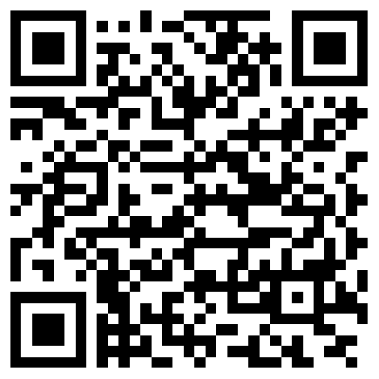
RoboCat - User Experience
ALEX VILD, QUINTIN FETTES, ZACH TAYLOR, KURTIS DAVIS, SEATTLE RUZEK, LUKE SHAYS

Slide 2
Experiment Conditions and Tasks
RoboCat is in behavior mode
“Rufus Vision” is on
“Rufus Vision” is off
Robocat is in face tracking mode
Robocat is in color tracking mode

Slide 3
Tasks
Robocat is given a command.
There is a room full of people, and Robocat needs to decide which face to recognize and track.

Slide 4
Logged Data Types
Robocat’s visual response to commands.
Robocat’s ability to recognize the emotions of the user.
Robocat’s movement following closest person to him when they move.
Notes:
Present

Slide 5
Questionnaires (UEQ)
User Experience Questionnaire for RoboCat
Based on six factors: attractiveness, perspicuity, efficiency, dependability, stimulation, and novelty.
unattractive | -3 | -2 | -1 | 0 | 1 | 2 | 3 | very attractive
difficult to use | -3 | -2 | -1 | 0 | 1 | 2 | 3 | easy to use
inefficient | -3 | -2 | -1 | 0 | 1 | 2 | 3 | efficient
feels independable | -3 | -2 | -1 | 0 | 1 | 2 | 3 | feels dependable
boring to use | -3 | -2 | -1 | 0 | 1 | 2 | 3 | exciting to use
unimaginative and dull | -3 | -2 | -1 | 0 | 1 | 2 | 3 | creative and interesting
Notes:
Present

Slide 6
Experiment Procedure
The user would be given access to the RoboCat with the Android running the RoboApp.
They would be familiar with his capabilities.
They would be asked to give him a few commands and have him track their face.
After they played with the cat for approximately 5-10 minutes or less (testing his capabilities), they would complete the UEQ.
Notes:
Present

Slide 7
Subject Description
The subject would be a user that is familiar with the RoboApp and his capabilities.
They could be a younger child (elementary or middle school age) who has an interest in robotics or an older student (undergraduate or graduate) who is studying robotics.
Notes:
Present

Slide 8
Results
what?
Notes:
Present

Slide 9
Reflection
User Experience Analysis is most definitely worthwhile.
It helps the developer understand how others view the application and how to improve the application in future releases.
Something that could be different:
The subject description should not be limited to one category of subjects. Although applications are usually targeted towards one group of people, I think capturing feedback from multiple groups of people would be useful. It could even spark new ideas about how the application could be used.

Slide 10
References
B. Laugwitz, T. Held, and M. Schrepp, “Construction and evaluation of a user experience questionnaire,” in: Holzinger, A. (Ed.): USAB 2008. LNCS 5298, pp. 63-76, 2008.
C. Dickie, G. Jakus, J. Sodnik, and S. Tomazic, “On the Evaluation of Auditory and Head-Up Displays While Driving,” in: ACHI 2012, The Fifth International Conference on Advances in Computer-Human Interactions. IARIA 2012, pp. 200-203, 2012.
Notes:
Present

